Slide 1

International Journal Management Platform
Management Scientific Journal
Sohag 2024

Slide 2
Under the Supervised of:
Team
Abdelrahman Badr eldin
Mohamed AbdelMontaser
Mahmoud Hamada Mostafa
Aly Othman Aly Mahmud
Mostafa Mohamed Ali
Mohamed Ahmed Gaber
Moaz Mohamed Elsayed
Prof.Walaa Elhady
Professor At The Egyptian E-Learning University.
T.A.Youssef Ayman
Teaching Assistant At The Egyptian
E-Learning University.

Slide 3
Content Outline
1- Introduction
2- Literature Review
3- Problem Statement
4- Key Features
5- Methodology
6- User-Friendly Interface
7- Courses
8- Tools & Technologies Used
9- Implementation
10- Our Project Video
11- Future Works
12- Conclusions
13- References

Slide 4
1- Introduction
Open Journal Systems (OJS) is a free and Open-Source software that enables users to manage and publish scholarly journals online. OJS was developed by the Public Knowledge Project (PKP), a research initiative that aims to improve the quality and reach of academic publishing.
OJS is used by thousands of journals around the world, covering various disciplines and languages.

Slide 5
Open Journal System (OJS)
Free and Open Source
Supports the entire workflow
Customize the appearance and functionality of their journals
integrates with external services and standards, such as Google Scholar - DOAJ

Slide 6
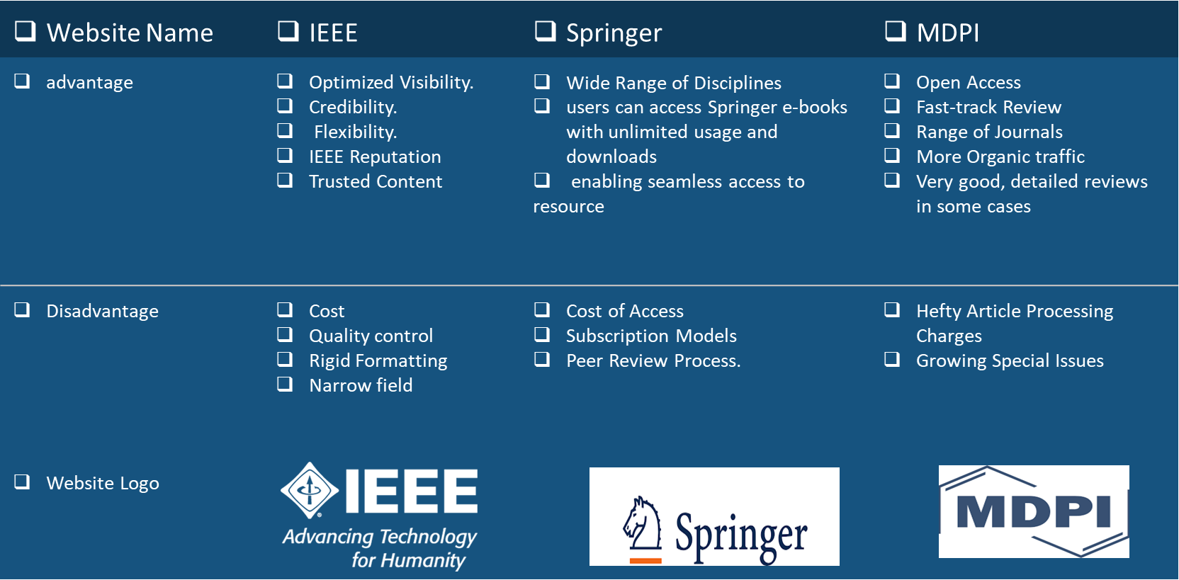
2- Literature Review

Slide 7
3- Problem Statement
Time and resource-intensive
Technical skills required
Limited support
Dependency on web server
Complex workflows

Slide 8
4-Key Features
Increased accessibility
User-friendly
Detailed statistics and metrics
Open access publishing
Customization and theming
Integration with indexing systems

Slide 9
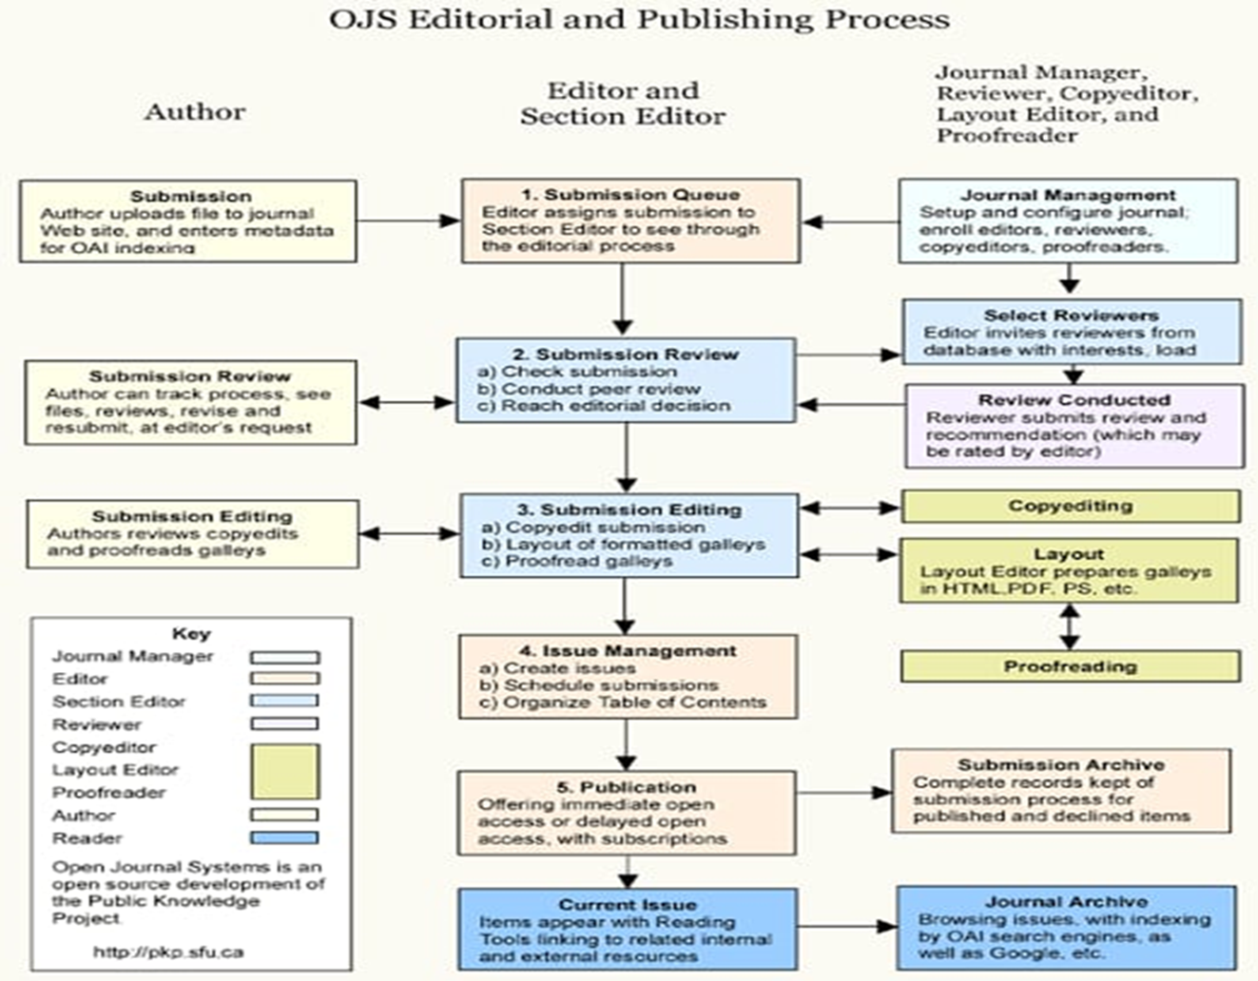
5- Methodology

Slide 10
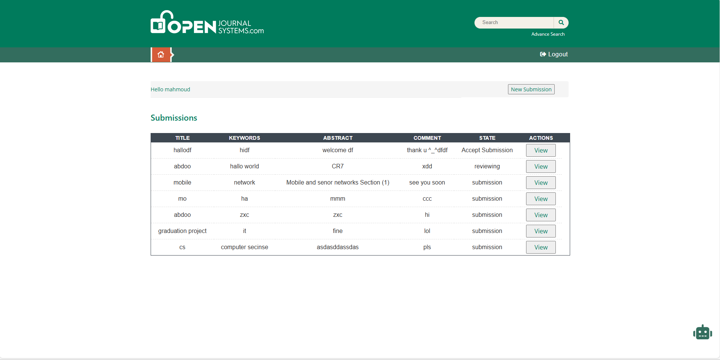
7-User-Friendly Interface(Author)

Slide 11
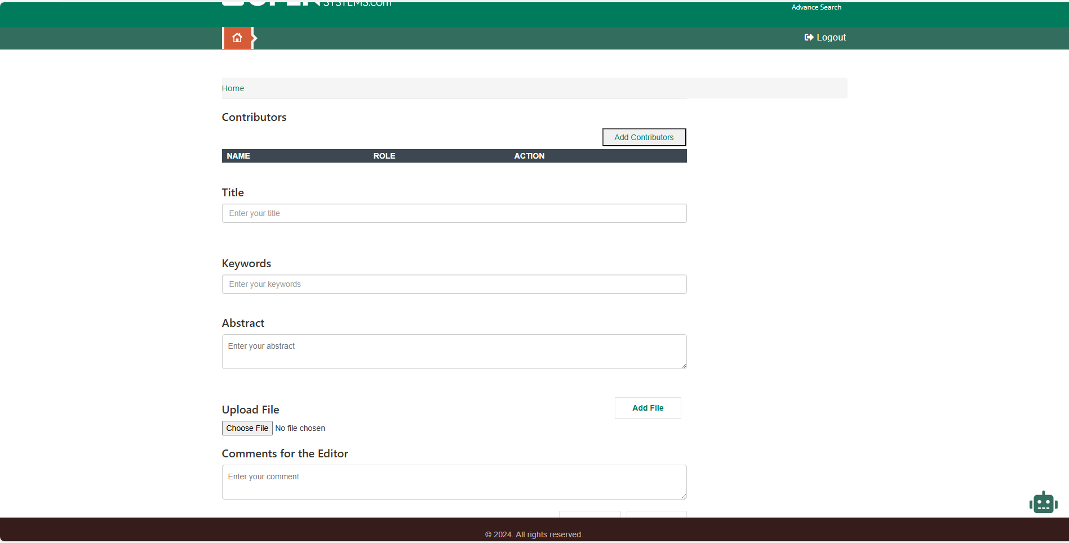
7-User-Friendly Interface(Author)

Slide 12
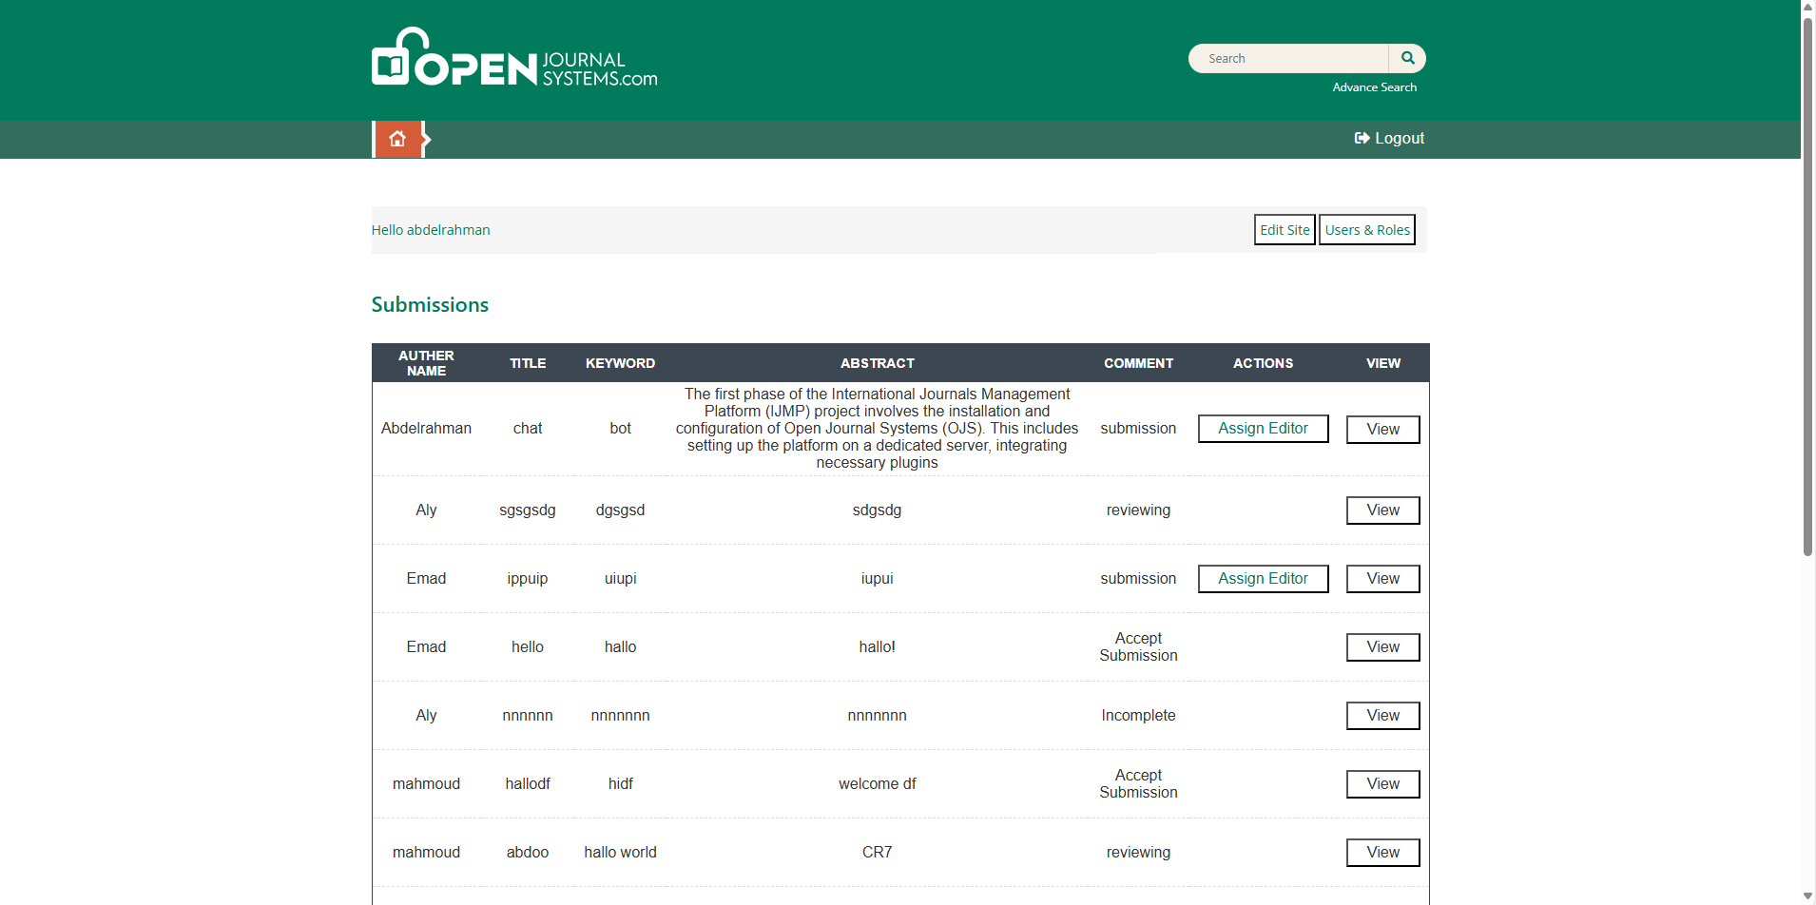
7-User-Friendly Interface(Admin)

Slide 13
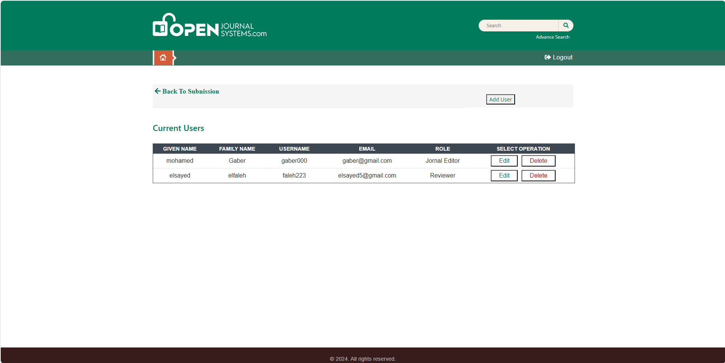
7-User-Friendly Interface(Admin)

Slide 14
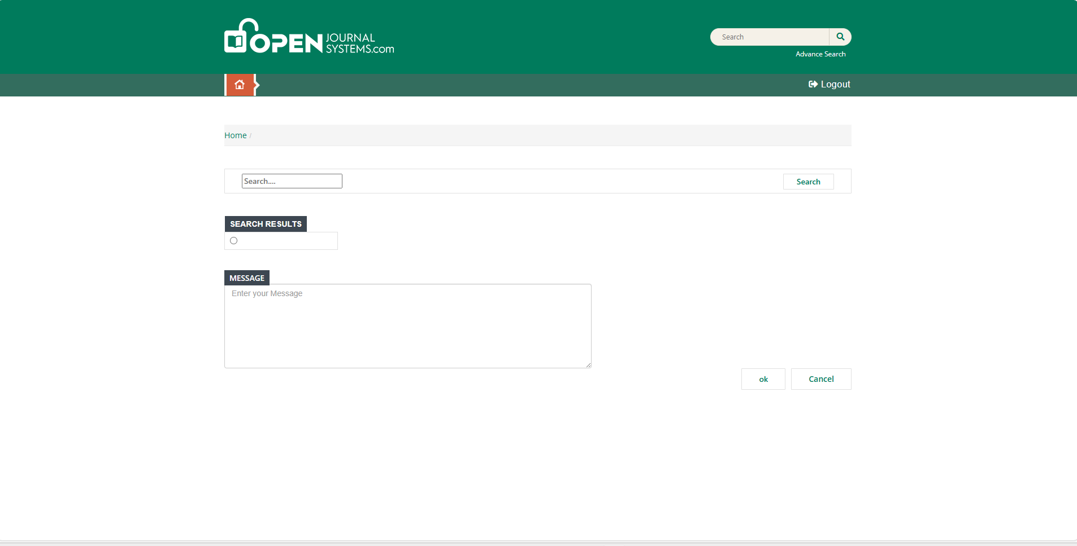
7-User-Friendly Interface(Admin)

Slide 15
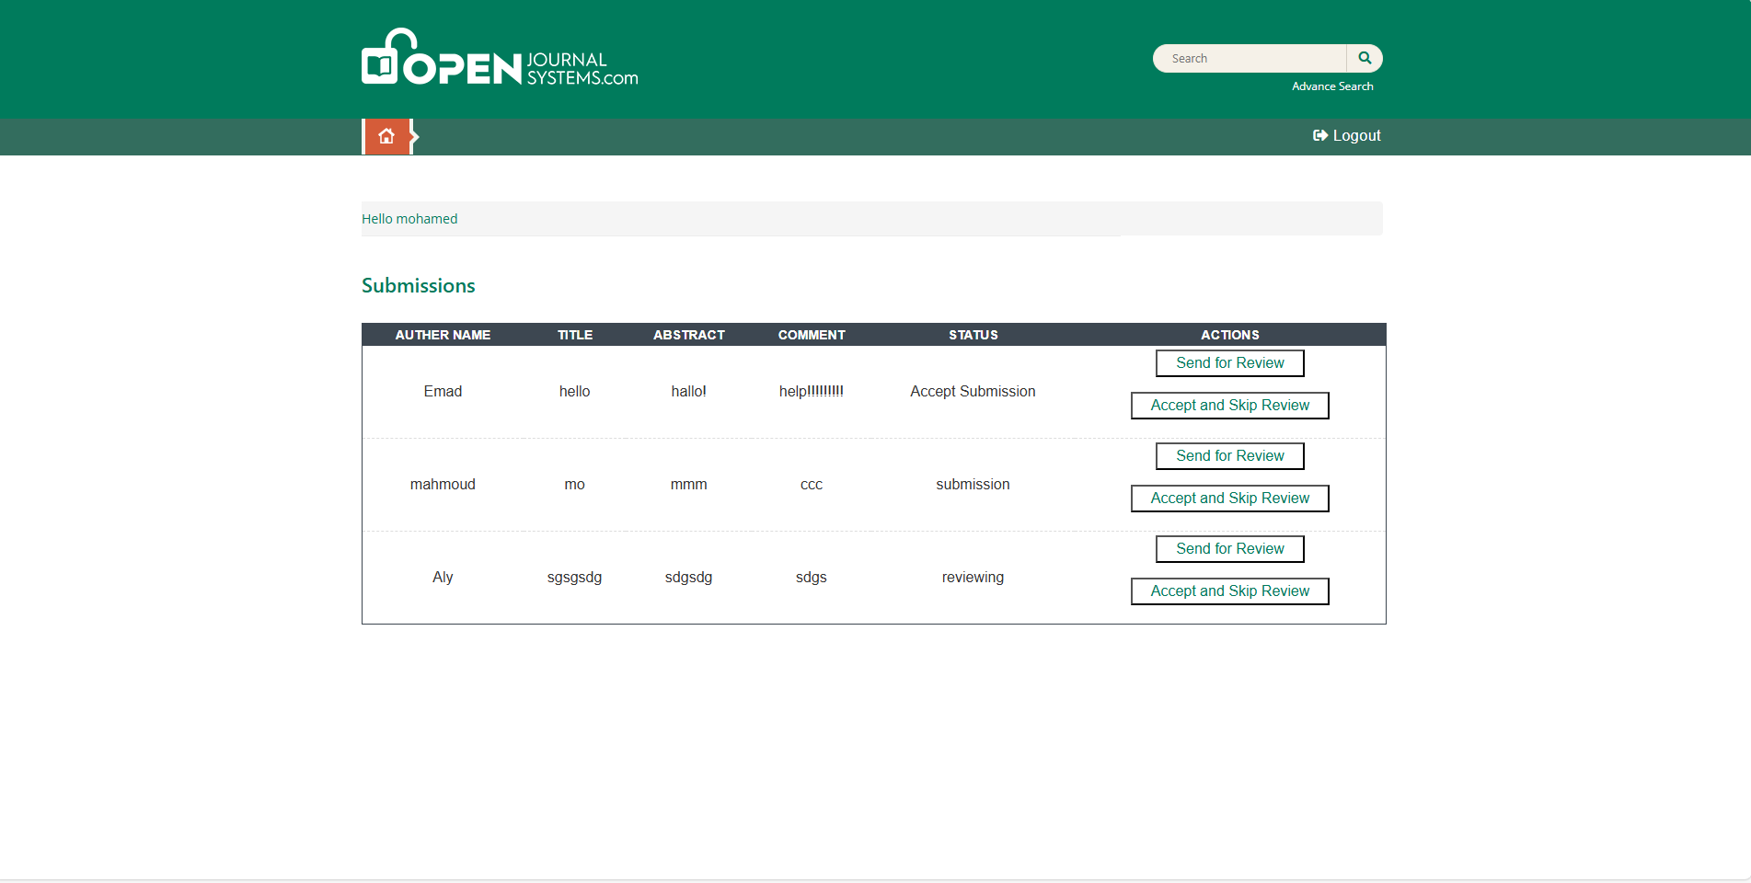
7-User-Friendly Interface(Editor)

Slide 16
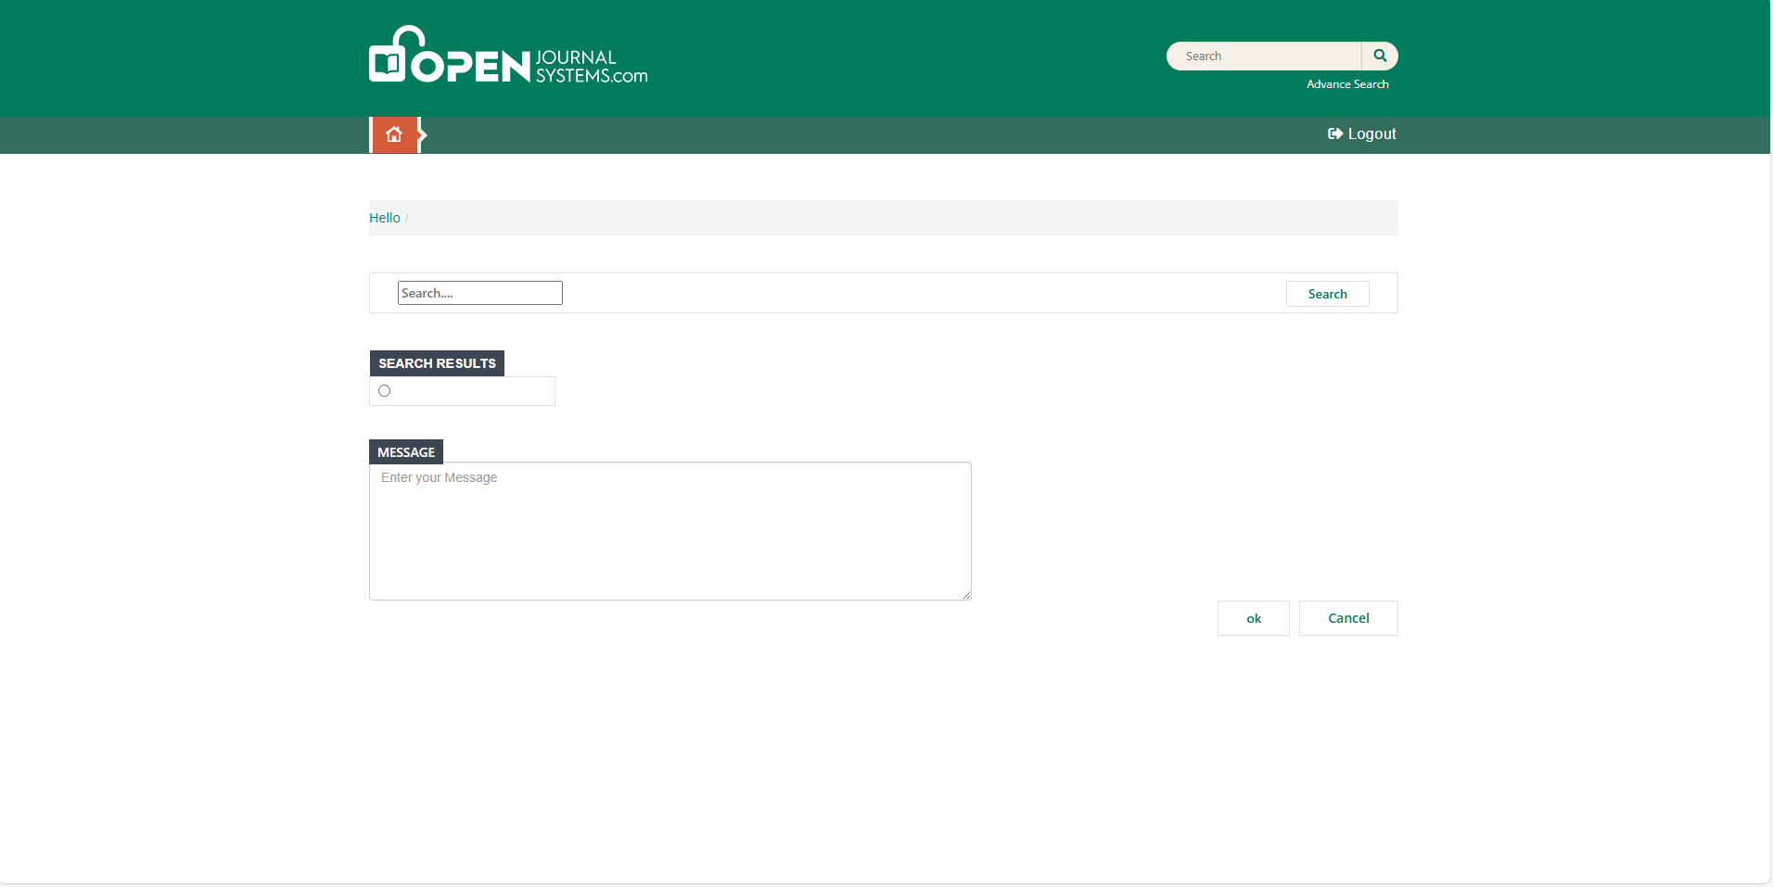
7-User-Friendly Interface(Editor)

Slide 17
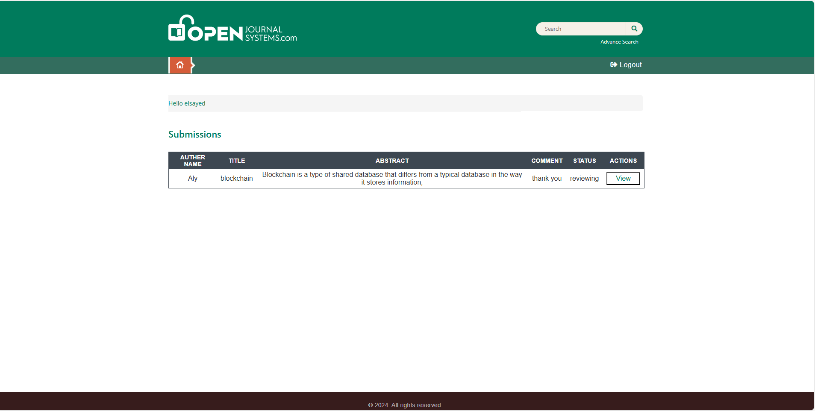
7.8-User-Friendly Interface(Reviewer)

Slide 18
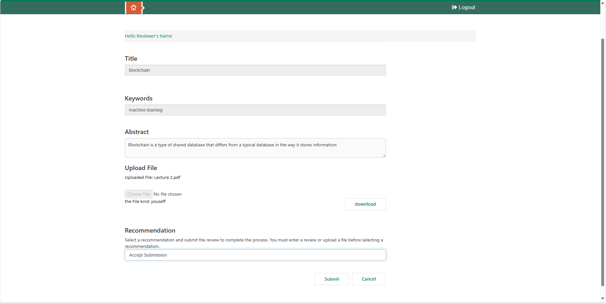
7-User-Friendly Interface(Reviewer)

Slide 19
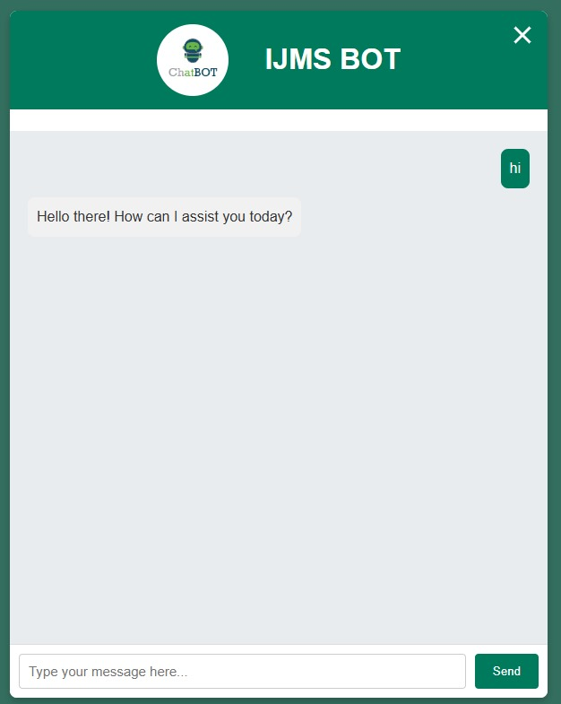
7-User-Friendly Interface(Chatbot)

Slide 20





8- Courses
Machine Learning Diploma
HTML+CSS
php
Supervised Machine Learning
JavaScript
Problem Solution
Machine Learning

Slide 21






9- Technologies Used
Xampp
Visual Studio Code
Figma Design
composer
Gemini Ai
My SQL

Slide 22




9- Technologies Used
HTML
CSS
PHP
JavaScript

Slide 23

10- Implementation
Vendor Layout
Composer
Gemini Model
Machine Learning

Slide 24

10- Implementation
client side:
HTML
CSS
JavaScript
FrontEnd

Slide 25

10- Implementation
Programing language:
PHP
Database:
MySQL
BackEnd

Slide 26
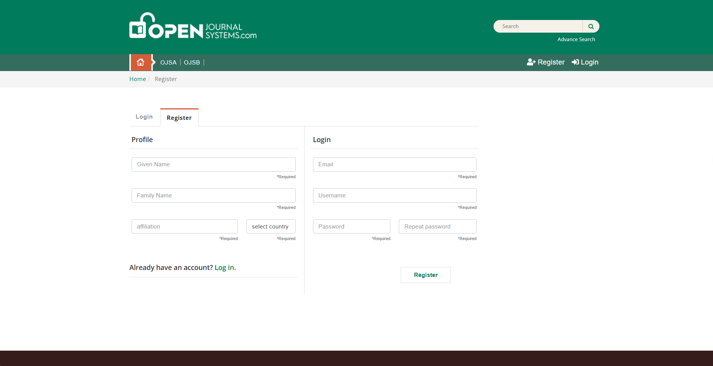
10- Implementation
Register Page
If you do not have an account,
you can create an account to
be able to use all the services
provided by the program.

Slide 27
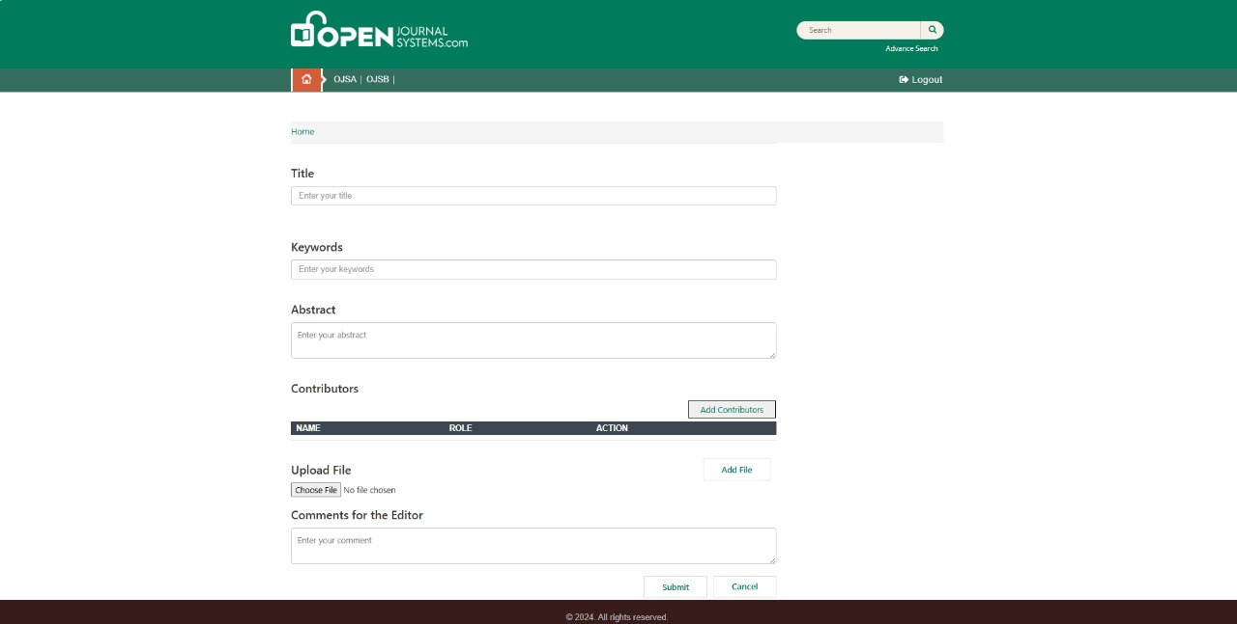
1- Author
10- Implementation
New Submission:
Title
Abstract
Upload File
Contributors
Editor Comment
Review
Submit

Slide 28
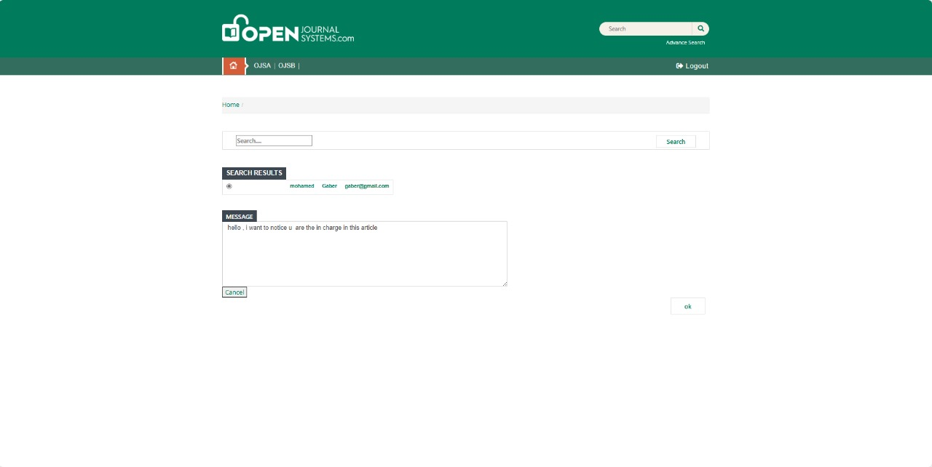
2- Admin
10- Implementation
Create Editor:
Name
Email
Country
Assign Editor

Slide 29
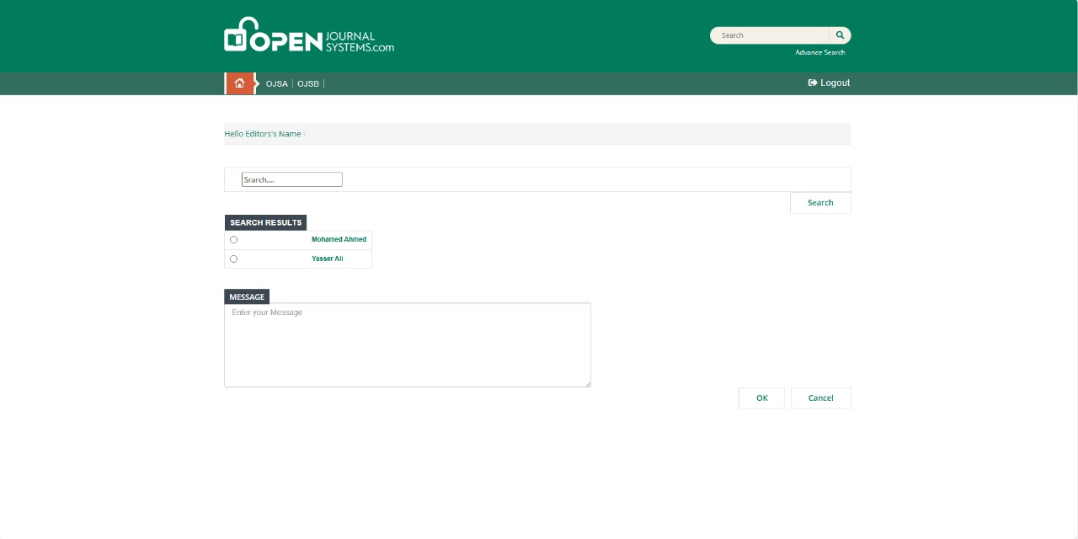
3- Editor
10- Implementation
Send for Review
Assign Reviewer
Accept and Skip Review
Decline Submission

Slide 30
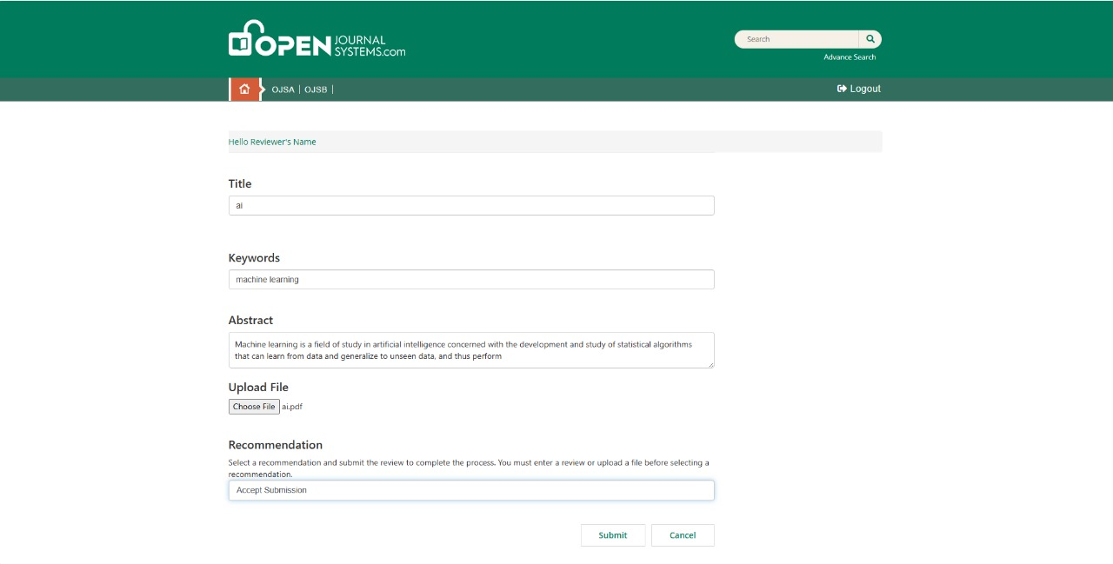
4- Reviewer
10- Implementation
Accept or Decline For Review
Accept :
Accept Summation
Decline Summation

Slide 31
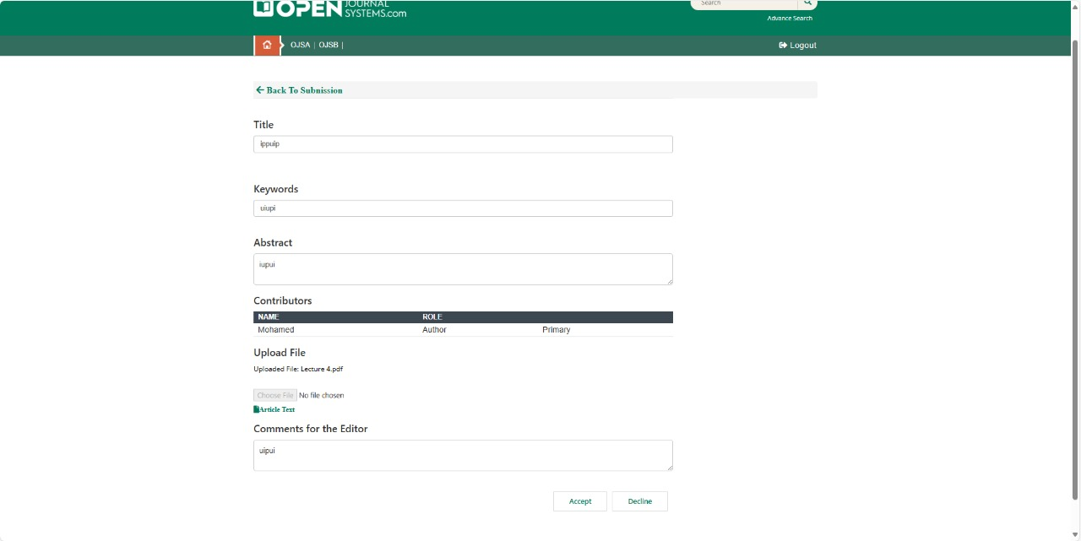
5- Editor
10- Implementation
Read Review And Rating
Accept Submission
Send To Product
Schedule for Publication

Slide 32
10- Implementation
Chat Bot Page
If you need to ask any question,
You can use chat bot

Slide 33

11-Our Project Video
Let’s Stop
5 Minutes
To Present Our Demo

Slide 34
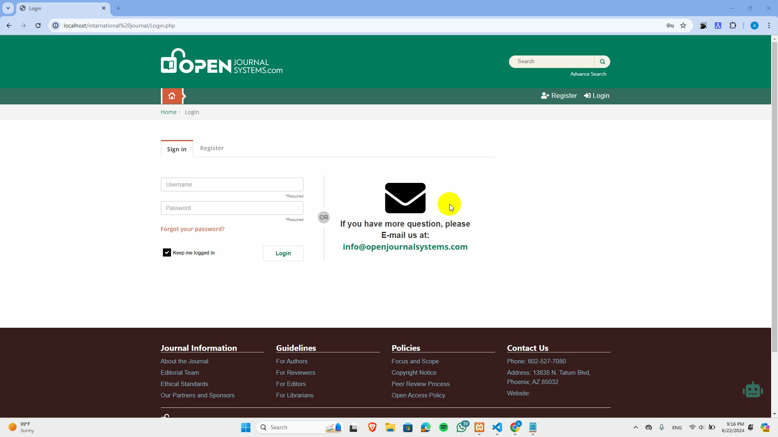

Slide 35

11- Future Work
Recommendation
Summarization

Slide 36

12- Conclusion
The graduation project delves into Open Journal Systems (OJS), a platform that streamlines editorial workflows, ensures transparency, and enhances research accessibility, highlighting its adaptability and potential to address academic publishing challenges.

Slide 37



13- References
https://www.ieee.org/
https://www.springer.com/gp
https://www.mdpi.com/

Slide 38



THANK YOU!

